Slide 1
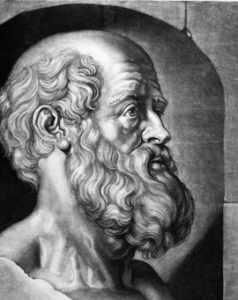
CSC111 Embedded Ethics Module 2 March 2021
Image source:
cornell.edu clicdata.com
Notes:
Image source:
https://as.cornell.edu/sites/default/files/styles/4_5/public/Hippocrates.jpg?itok=8WmtECKD
https://www.clicdata.com/wp-content/uploads/2018/06/blog-machine-learning-proactive-analytics.png

Slide 2
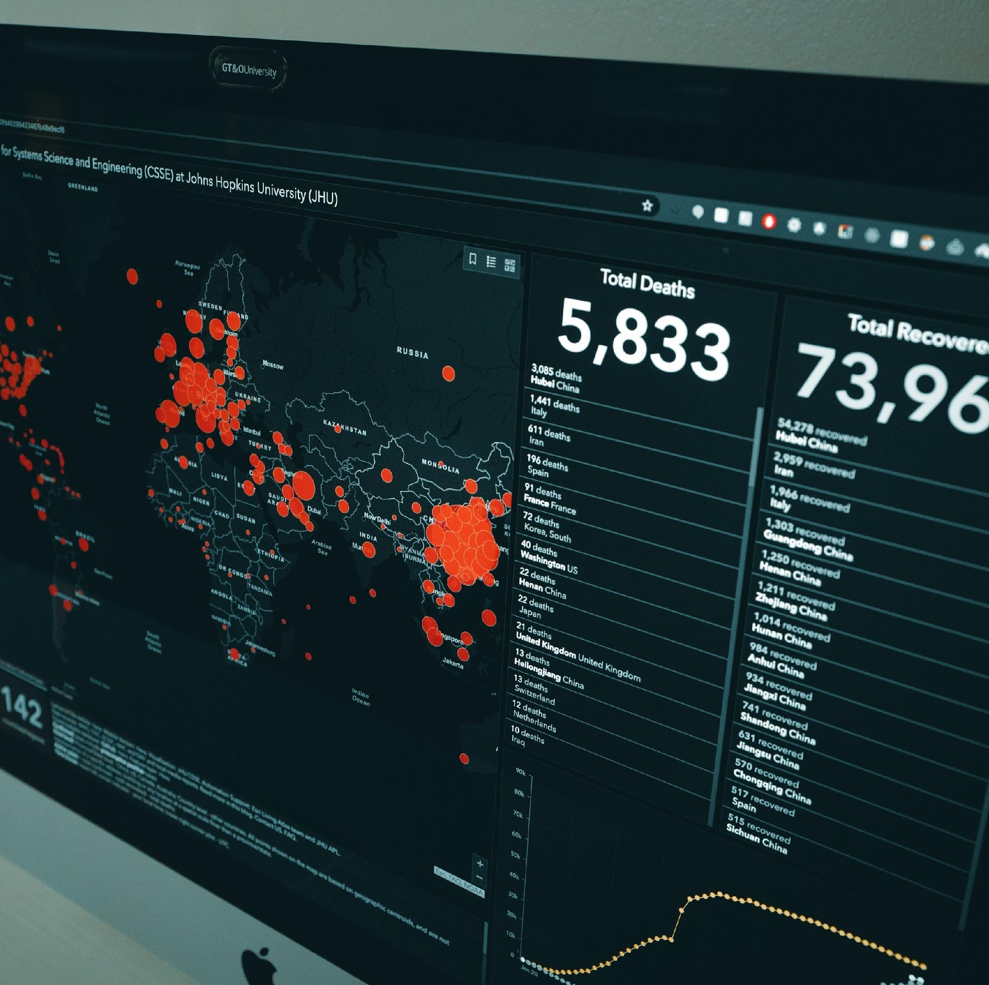
More data
Higher quality services
Age
Age
health-profile
DNA
job
daily activity
Notes:
Script:
When it comes to a complex problem such as the COVID-19 pandemic, individuals’ demographic data such as age, health-profile, DNA, job, and even daily activity are tremendously valuable. These data can help organizations provide higher quality services, and help researchers solve difficult problems such as forecasting how the pandemic will evolve or deciding which groups should receive priority for vaccination.

Slide 3
Study by NCBI:
Over 78 %
Felt positively about the use of routinely collected data for health research.
Survey by KPMG Canada
92 %
Felt that digital contact tracing apps should balance privacy concerns with public safety.
Notes:
Reference:
https://www.ncbi.nlm.nih.gov/pmc/articles/PMC6450795/pdf/cmajo.20180105.pdf
Script:
A study conducted in 2017 on a sample group of Canadians, showed that over 78 percent of the respondents felt positively about the use of routinely collected data for health research. However, according to a survey conducted by KPMG Canada in May 2020, 92 percent of Canadians felt that digital contact tracing apps should balance privacy concerns with public safety. These studies suggest that, while most people are willing to share their personal health information, they wish to preserve their privacy at the same time.

Slide 4
So, if we collect data, can we protect individuals’ privacy by removing names to anonymize the data?
Notes:
Script:
So, if we collect data, can we protect individuals’ privacy by removing names and anonymizing them?hem?

Slide 5
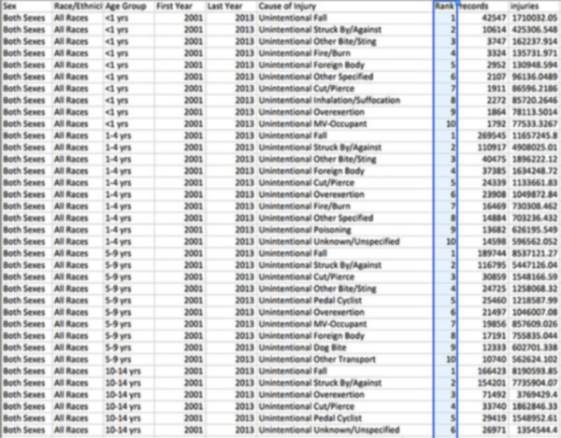
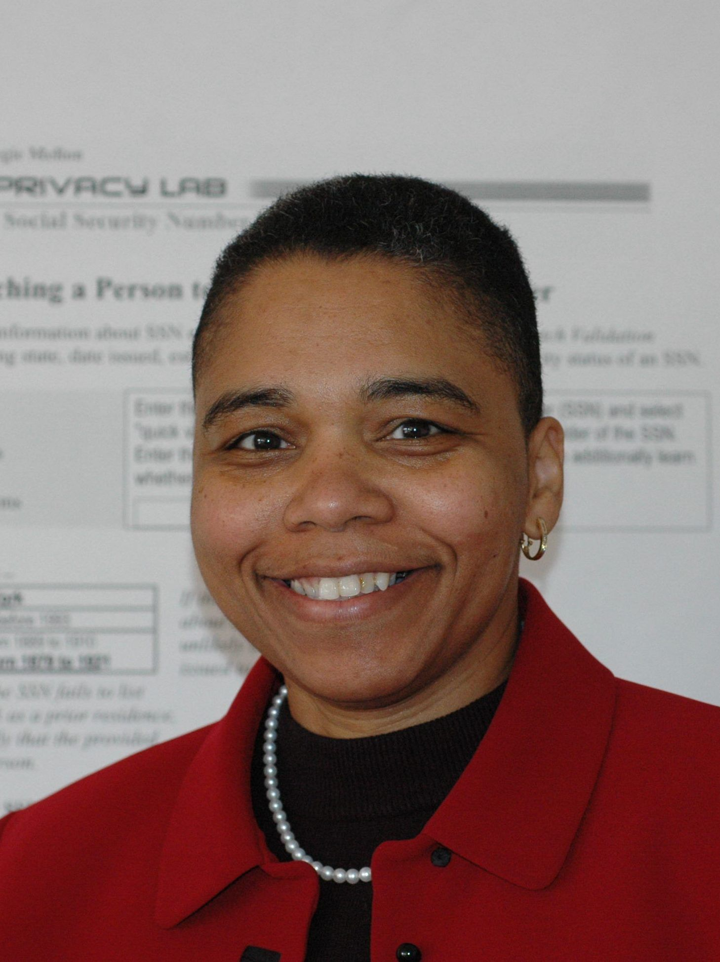
One source of data
States Group Insurance commission
published “anonymized” hospital visits data
Removed names, addresses, and
other fields that could potentially identify people
Published
Notes:
Reference:
https://arstechnica.com/tech-policy/2009/09/your-secrets-live-online-in-databases-of-ruin/
Script:
This might work well if people only have access to one source of data about a person.
In the mid-1990s, the States Group Insurance commission in the United States published data including information about the hospital visits of state employees. They anonymized the data by removing names, addresses, and other fields that could potentially identify people.
Later, in a paper that received much media attention, Dr. Latanya Sweeny, a graduate student at that time, showed how easy it was to reverse the anonymization by combining the health data set with voter registration records.

Slide 6
Diagnosis
Age
Zip code
Gender
Name
Age
Zip code
Gender
Age
Zip code
Gender
Diagnosis
Name
Data considered for sharing
Age | Zip code | Gender | Diagnosis
15 | 00000 | Male | Diabetes
21 | 00001 | Female | Influenza
36 | 10000 | Male | Broken arm
91 | 10001 | Female | Acid reflux
Data considered for sharing
Birthdate | Zip code | Gender | Name
2/2/1989 | 00001 | Female | Alice Smith
3/3/1974 | 10000 | Male | Bob Jones
4/4/1919 | 10001 | Female | Charlie Doe
Notes:
Reference:
https://www.bostonmagazine.com/news/2016/08/21/bill-weld/
https://arstechnica.com/tech-policy/2009/09/your-secrets-live-online-in-databases-of-ruin/
Script:
She matched the medical records to the shared zip code, gender, and date of birth found in the voter registration record, and presto!
The hospital visits of the state employees were exposed. This resulted in revealing the governor of Massachusetts’ health condition. Sweeny also showed that 87 percent of the American population can be identified with only three pieces of information: zip code, birthday, and gender.

Slide 7
Notes:
Script:
So, for any anonymized dataset someone could use another data set, which has a few fields in common with the anonymous set, but with a name connected to each record. Then, by combining those two data sets, they would be able to uniquely identify nearly all individuals.
Once individuals have been identified, personal information can be extracted, which may reveal interesting or embarrassing information that individuals may not want others to know.
So, what appears to be an anonymized set of data, can in fact be used to easily identify individuals. Even if the data is anonymized in a way that precludes it being combined with any existing data set to identify people, it is very difficult to protect against all possible future databases that may arise with names attached to them. And that is the fundamental problem with anonymization. If we collect and store data about individuals, then there is always the potential for that data to be used to re-identify them.

Slide 8
So, what should we do?
The Personal Information Protection and Electronic Documents Act (PIPEDA)
Principle 4 - Limiting Collection
“The collection of personal information shall be limited to that which is necessary for the purposes identified by the organization. Information shall be collected by fair and lawful means.”
Principle 5 – Limiting Use, Disclosure, and Retention
“Personal information shall not be used or disclosed for purposes other than those for which it was collected, except with the consent of the individual or as required by law. Personal information shall be retained only if necessary, for the fulfillment of those purposes.”
Notes:
Script:
So, what should we do?
One way to protect privacy, both now and in the future, is by limiting the amount of personally identifiable information that is collected.
Limited collection is a requirement of Canada’s Personal Information Protection and Electronic Documents Act (PIPEDA) and is mentioned in its principle 4: Limiting Collection
“The collection of personal information shall be limited to that which is necessary for the purposes identified by the organization.”
and principle 5: Limiting Use, Disclosure, and Retention
“Personal information shall be retained only if necessary, for the fulfillment of those purposes.”
So, information should only be collected if it is needed, and when it is needed, and retained only as long as necessary.

Slide 9
Takeaways
Individuals identified with a few pieces of personal information
Privacy difficult to protect against all possible future datasets
Solution
Limited collection 🡪 PIPEDA principles
Notes:
Script:
We have seen that individuals can be identified with only a few pieces of personal information when combined with data from other sources. We also know that it is very difficult to protect privacy against all possible future databases that may arise with identifiable data attached to them. PIPEDA explains that one way to protect privacy is to limit the collection of data. In the coming module, we will apply what we’ve learned to develop a design for a contact tracing application that protects privacy while helping the fight against COVID-19.

